Slide 1
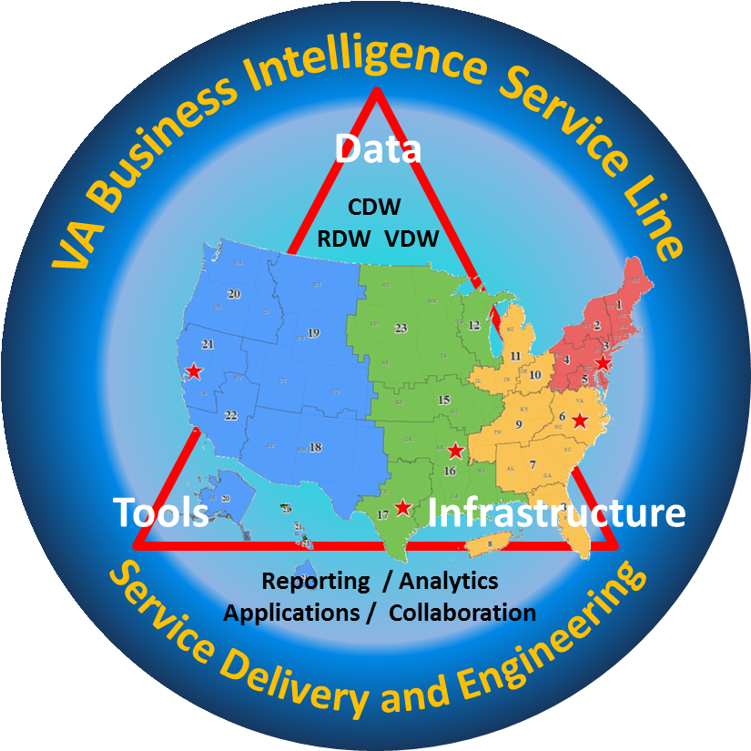
Building an Enterprise Natural Language Processing Solution for the VA
VA Business Intelligence Service Line
Joseph Erdos MD PhD
Director District One (East Coast) Data Warehouse

Slide 2
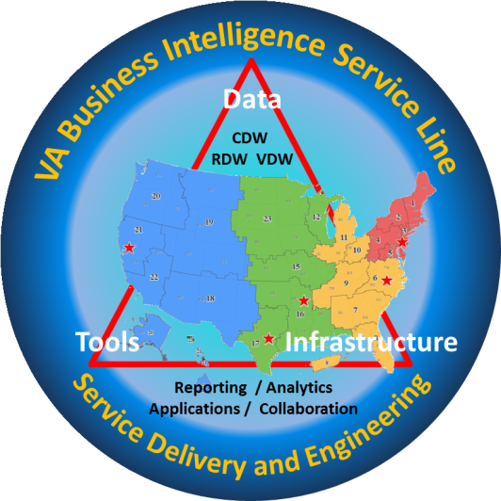
Who am I ?
Husband
Father
Brother
Pharmacologist (PhD in intercellular messaging)
Psychiatrist (PTSD and Trauma)
Educator (Med Students and Fellowship Co-Director)
Informaticist (Board Certified)
  CIO (1995 to 2009)
  East Coast Director of BISL (VISNs 1-5 (6 coming in)
Cyclist
Reader of Zen (Mindfulness and Trauma)

Slide 3
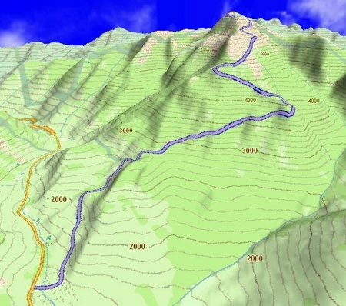
Goal Race Mount Washington
4685 feet climbing from base (1600 ft) to summit (6285 ft)
7.6 miles
Average grade (rise/run) = 11.7 %
22% grade at finish on the mountain face
Two nasty switchbacks

Slide 4
VA Corporate Data Warehouse
All along VA groups have been taking data from VistA and putting it into external data bases
VistA excels as a transactional electronic medical record but is facility-based and has difficulty aggregating data
Opportunity to consolidate data warehousing efforts presented itself in 2007
We all had done data warehousing and failed many times
Worked out the ability to shadow VistA platforms remotely
Worked out the ability to shadow (exploiting journaling capability of Cache) changes in VistA cache environment into Microsoft SQL environment.
  130 VistA platforms are shadowing live

Slide 5
VA Corporate Data Warehouse
CDW is now source of VA data for analysis, performance and Research (VINCI)
  >16 years of longitudinal data on > 22.3M veterans
  > 200 million rows of data/day → > 2.4 trillion
  80% of all VA data, doubling annually
  80,000 users throughout VA
>650 user-driven analytic solutions
125,000 reports and 2,500 dashboards
FY 2017 opportunity with Department of Energy to host and analyze VA data at Oak Ridge National Laboratories. Comes with significant consulting.
What do I do ? Try to build enterprise solutions and transfer research informatics into production

Slide 6
BISL Enterprise Enclaves & Applications
VISTA Shadow System(s)
FDW/RDW
VX-130
Raw
Enterprise Data & Project Enclaves
GP
(A01)
ER
(SQL12)
FR
(TBD)
AA
(SQL13)
RD
(RB01)
Scale
Out
Enterprise Application Farms
Operation Dashboard
SSIS
Farm
SSAS
Farm
Share P0int
Farm
ESRI GIS
Farm
SAS
Farm
Pyramid
Farm
Backup
Farm
TFS
Farm
Remote
Desktop Farm

Slide 7
VA CT NLP Cancer Care Tracking System
VISTA Cache
VA CT
NLP Application Server YTEX
DIAGNOSTIC_CODES_78_3 – List of radiology alert codes
Patient_2 (SSN, NAME, LAST4, ID)
RADNUC_MED_REPORTS_74 – Report Text
RADX_EXAMINATIONS_70_03 – Exam datetime
RADXX_SECONDARY_DIAGNOST_70_14 – Secondary alerts listed
Project DBs
VA CT
Annotations
SQL
Server
Annotations
Annotation DB
Lung
Output DBs
Liver
IIS Server
(Workflow)
Other
- Nightly jobs get list of new reports and NLP processes each for suspicious cases
- Process extracts table index values. No bulk downloads of VISTA tables.
Carolyn Taylor MD
Cynthia Brandt MD
Donna Vogel MSN
Vijay Garla
Woody Levin MSN

Slide 8
CCTS: Text Mining vs. Manual Coding
Utilized Clinical Text Analysis and Knowledge Extraction System (cTAKES) with the Yale cTAKES Extensions (YTEX), an open-source, clinical NLP pipeline to process radiology report.
The NLP pipeline annotates syntactic structure (e.g. sections, sentences, phrases), semantic content (concepts), and performs negation detection. Due to the scarcity of the training data, we developed rules to classify radiology reports.
We configured cTAKES to map text from radiology reports to concepts from the Unified Medical Language System (UMLS), a compendium of biomedical vocabularies and ontologies that includes SNOMED-CT, ICD-9 and others.
We extended the UMLS and added concepts relevant to the classification of cancer alerts, in particular, concepts that pertain to radiographic abnormalities. In addition, we introduced semantic relationships to define coarse concept groups for this classification task
From Roxanne J Wadia MD Medical Informatics and Hematology and Medical Oncology manuscript in preparation

Slide 9
CCTS: Text Mining vs. Manual Coding
In order to establish a gold standard validation set, the three reviewers (RJW, MGR, AM) systematically reviewed the reports according to a set of mutually agreed upon rules to determine positive and negative reads. In order to establish these rules, 20 reports were randomly selected and reviewed individually by each of the reviewers. Positive by gold standard implicated that the report recommended follow-up for concern for neoplasm. Negative by gold standard meant that per the report, there was no increased concern for neoplasm and that the patient did not require more than the clinically indicated standard cancer screening. Utilizing these 20 CT reports an initial set of abstraction rules was written to establish the gold standard. Utilizing these preliminary rules, an additional 30 charts were evaluated in triplicate by the three reviewers for agreement. The abstraction rules were then edited to further eliminate ambiguities in abstraction.
From Roxanne J Wadia MD Medical Informatics and Hematology and Medical Oncology manuscript in preparation

Slide 10
CCTS: Text Mining vs. Manual Coding
The final rules are as follows:
If radiologist explicitly states that follow-up is needed for assessment of a lesion concerning for malignancy- this is considered positive.
If read explicitly states follow-up is needed for a non-malignancy related concern, Ex: AAA, this is considered negative.
Abnormalities outside of the lung that are concerning for malignant process are considered positive.
Lymph nodes of <1cm do not need follow-up unless explicitly stated or unless their appearance is suspicious on CT.
If nodules are <4mm and are stable for ≥1 year, they are not felt to require follow-up. However, this must be explicitly stated by the radiologist or it must be noted in the read that comparison images were ≥1 in the past.
If recommendation is to “return to routine screening”, this is interpreted as not requiring follow-up.
Utilizing these rules, the remaining 400 charts were split between the three reviewers and individually abstracted; the gold standard read (positive vs negative) was abstracted, as well as whether the imaging was ordered for oncologic follow-up. Ambiguous charts were identified and adjudicated by all three reviewers. Four reads were eliminated as they were duplicates, reported twice due to the method in which the imaging was ordered. From Roxanne J Wadia MD Medical Informatics and Hematology and Medical Oncology manuscript in preparation

Slide 11
Overall structure of Cancer Tracker NLP algorithm
Radiology Read
yes
Lung Image
no
positive
Liver image
no
positive
Other
no
yes
yes
positive
Cancer alert
no
yes
no
yes
Cancer alert
NO ALERT
Cancer alert

Slide 12
Classification of Lung Radiology Report Text
Radiology Report
To next algorithm (See fig 2
N
Lung Text?
Y
Benign finding?
yes
no
Followup needed?
Cancer alert
yes
no
Cancer alert
No cancer alert, to next algorithm (see Fig 2)

Slide 13
CCTS: Text Mining vs. Manual Coding
Liver: Results based on Cancer Care Coordinator review of reports from one week in February 2011 of 100 reports
Coding | Sensitivity | Specificity | PPV | NPV | F1-Score
Manual | 61% | 100% | 100% | 73% | 76%
Automated | 84% | 92% | 91% | 85% | 87%
Lung: Results based on Expert Review Jul-Aug 201 of 421 Reports
Coding | Sensitivity | Specificity | PPV | NPV | F1-Score
Manual | 57% | 100% | 100% | 60% | 73%
Automated | 97% | 83% | 87% | 96% | 92%

Slide 14
CCTS: Text Mining vs. Manual Coding
Distribution of reads: NLP coding vs Gold Standard Manual coding vs Gold Standard
Roxanne J Wadia MD manuscript in preparation
 | Gold Standard
NLP Coding |  | Positive | Negative | Total
 | Positive | 252 | 33 | 285
 | Negative | 72 | 87 | 161
 | Total | 326 | 120
 | Gold Standard
Manual Coding |  | Positive | Negative | Total
 | Positive | 168 | 21 | 189
 | Negative | 158 | 99 | 257
 | Total | 326 | 120

Slide 15
CCTS: Text Mining vs. Manual Coding
Roxanne J Wadia MD
Coding | Sensitivity | Specificity | PPV | NPV
NLP | 77.3% | 72.5% | 88.4% | 54%
Manual | 51.5% | 82.5% | 88.9% | 38.5%
Sensitivity, Specificity, Positive Predictive Value (PPV) and Negative Predictive Value (NPV) NLP vs manual coding
Coding | Sensitivity | Specificity | PPV | NPV
NLP | 79.1% | 60% | 90% | 38.7%
Manual | 54.9% | 73.3% | 90.4% | 26.3%
Subgroup Analysis of Reads ordered for Cancer-Related Indications
Coding | Sensitivity | Specificity | PPV | NPV
NLP | 71.1% | 86% | 80% | 79%
Manual | 37.8% | 91.2% | 77.3% | 65%
Subgroup Analysis of Reads ordered for Non-Cancer-Related indications

Slide 16
CCTS implementation impact VA CT: Finding Cancer at Earlier Stages
Lung (2015 vs. 2010): 22% more Stage I & II cases; 17% less Stage III & IV cases
Liver (2015 vs. 2010): 7% more Stage I & II cases; 1% less Stage III & IV cases
Tamar Taddi MD

Slide 17
CCTS implementation impact VA CT: Liver Cancer Stage Migration
Liver BCLC Stage Migration - West Haven
Percent Distribution by BCLC Stage
Tamar Taddi MD

Slide 18
CCTS implementation impact VA CT: Earlier Stages Compared to National Data
Percent Stage I & II Liver Cancer Cases
VA Connecticut vs National Cancer Database (NCDB)
Tamar Taddi MD

Slide 19
CCTS implementation impact VA CT: Earlier Stages at VA CT Compared to National Data
Percent Stage I & II Lung Cancer Cases
VA Connecticut vs National Cancer Database (NCDB)
Tamar Taddi MD

Slide 20
CCTS implementation VISN 2S:
Decreased time between diagnosis & treatment of Liver Cancer
* No changes implemented

Slide 21
VA CT NLP Cancer Care Tracking System
Multiple Site VISTA Cache
NLP App Server
West Haven
Providence
Bronx
Manhattan
Hudson Valley
Houston
Togus
Manchester
Providence
Cleveland
Phoenix
Pending Requests
Seattle (pending)
Philadelphia
WRJ
Salisbury
Dayton
Albany
Charleston
Project DBs
Multiple Sites
Annotations
SQL
Server
Annotations
Annotation DB
Output DBs
Lung
Liver
IIS Server
(Workflow)
Other
Carolyn Taylor MD
Cynthia Brandt MD
Donna Vogel MSN
Vijay Garla
Woody Levin MSN

Slide 22
BISL Enterprise Enclaves & Applications
VISTA Shadow System(s)
FDW/RDW
VX-130
Raw
Enterprise Data & Project Enclaves
GP
(A01)
ER
(SQL12)
FR
(TBD)
AA
(SQL13)
RD
(RB01)
Scale
Out
Enterprise Application Farms
Operation Dashboard
SSIS
Farm
SSAS
Farm
Share P0int
Farm
ESRI GIS
Farm
SAS
Farm
Pyramid
Farm
Backup
Farm
TFS
Farm
Remote
Desktop Farm
NLP

Slide 23
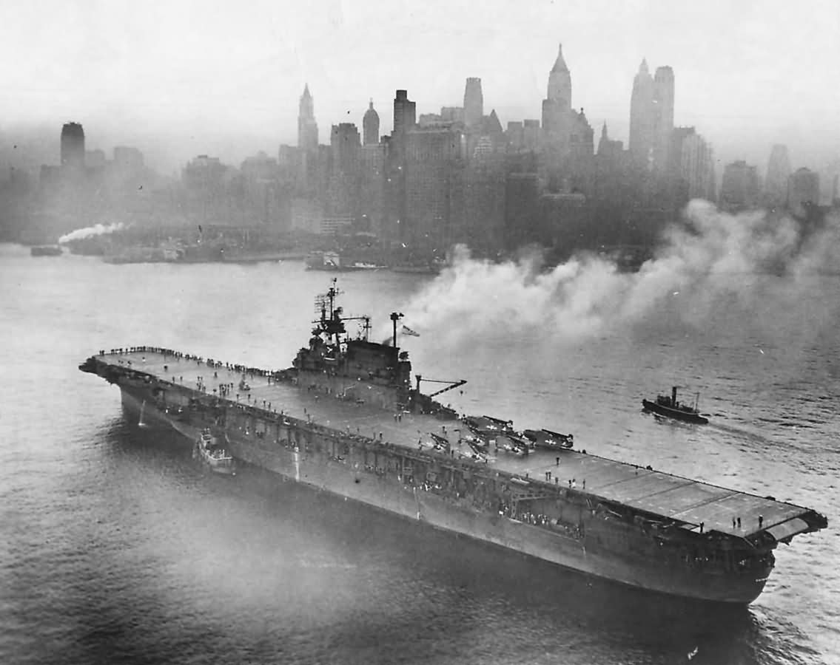
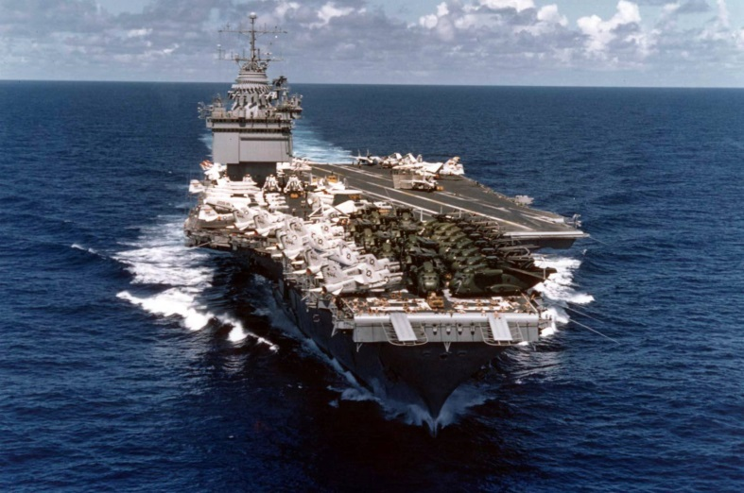


Reflections on Enterprise
USS Enterprise CV 6
USS Enterprise CV 66
Starship Enterprise
Space Shuttle Enterprise

Slide 24
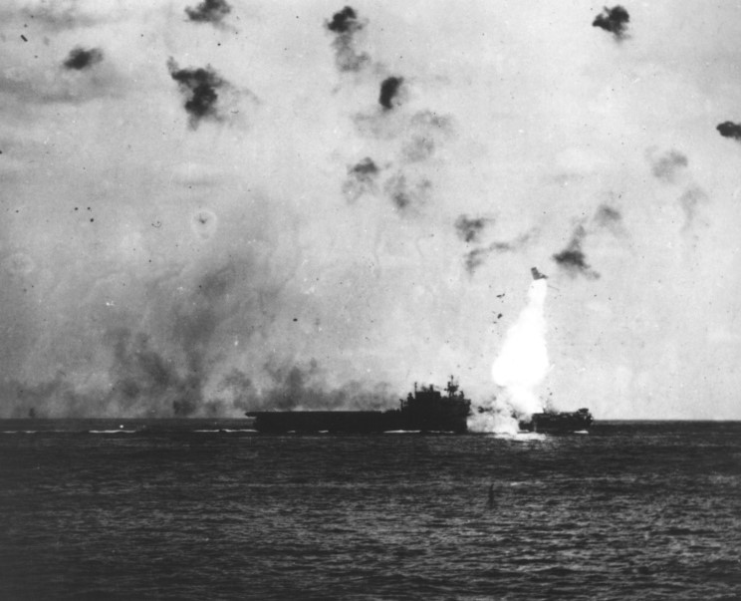
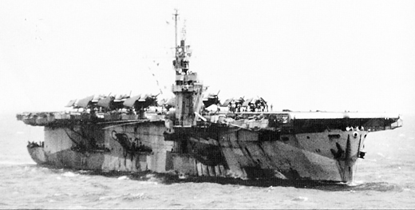
USS Enterprise and USS Nehenta Bay
USS Enterprise CV6
USS Nehenta Bay CVE-74
USS Enterprise CV6 entered World War II on the morning of December 7, 1941, when her scout planes encountered the Japanese squadrons attacking Pearl Harbor. Not until May 14, 1945, when a Kamikaze attack off Kyushu, Japan, left a gaping hole in her flight deck, was she forced to leave the war.
Of the more than twenty major actions of the Pacific War, Enterprise engaged in all but two. Her planes and guns downed 911 enemy planes; her bombers sank 71 ships, and damaged or destroyed 192 more. Her presence inspired both pride and fear: pride in her still unmatched combat record, and fear in the knowledge that Enterprise and hard fighting were never far apart.

Slide 25
BISL Enterprise Domain Development
VistA 130 Distinct Systems
VistA Shadow Systems
FDW shadows with VistA in real time. Data is not indexed or modeled or collapsed into domains. Hardware is optimized for shadowing, ETLs are driven off of the FDW for CDW 24 X 7.
VX 130 uses ETL processes to shadow selected fields in FDW and move it into CDW or RDW DBs. Requires work. Some modeling and transformation can happen. Daily updates though ETL. Multiple tables.
Raw is extracted from VistA or the VistA shadows on a bi-weekly or monthly schedule with little transformations, indexes, or changes to naming conventions. Multiple tables.
CDW is highly modeled and highly indexed with multiple tables collapsed into more logical subject domains. Unique SID for each row allows incremental ETL loading.
FDW
Raw
NVX 130
CDW

Slide 26
BISL Enterprise Radiology Domain Built in Raw and NVX 130 and here is the Metadata
Rob Woody, Donna Reagan, Beth Gibson, NVX 130 Team
PSCI_CCTS Database Table | PSCI_CCTS FieldName | PSCI_CCTS Fields and datatype | Vista Field from CDWRAW
[Radiology].[RADNUC_MED_PROCEDURES_71]
 | Sta3n | [Sta3n] [int] NOT NULL | station__no
 | RowID | [RowID] [int] NULL | row_id
 | Name | [Name] [varchar](250) NULL | name
 | CptCodeIEN | [CptCodeIEN] [varchar](30) NULL | cpt_code
 | CptCodeName | [CptCodeName] [varchar](256) NULL | cptcodex
 | Inactivation_Date | [Inactivation_Date] [datetime2](0) NULL | inactivation_date
[Radiology].[RADXX_SECONDARY_DIAGNOST_70_14]
 | Sta3n | [Sta3n] [int] NOT NULL | station__no
 | RowID | [RowID] [varchar](256) NULL | Row_id
 | SubExaminations | [SubExaminations] [varchar](256) NULL | sub_examinations
 | SecondaryDiagnosticCodeIEN | [SecondaryDiagnosticCodeIEN] [int] NULL | secondary_diagnostic_code
 | SecondaryDiagnosticCode | [SecondaryDiagnosticCode] [varchar](256) NULL | secondarydiagnosticcodex
 | SecondaryDxPrintDate | [SecondaryDxPrintDate] [datetime2](0) NULL | secondary_dx_print_date
 | LastUpdate | [LastUpdate] [datetime2](0) NULL

Slide 27
BISL Enterprise Radiology Domain
Rob Woody, Donna Reagan, Beth Gibson, NVX 130 Team
PSCI_CCTS Database Table | PSCI_CCTS FieldName | PSCI_CCTS Fields and datatype | Vista Field from CDWRAW
[Radiology].[RADNUC_MED_REPORTS_74]
 | Sta3n | [Sta3n] [int] NOT NULL | station__no
 | RowID | [RowID] [bigint] NOT NULL | row_id
 | DayCase | [DayCase] [varchar](256) NULL | DayCase
 | PatientIEN | [PatientIEN] [varchar](50) NOT NULL | patient_name
 | PatientName | [PatientName] [varchar](100) NULL | patientnamex
 | ExamDateTime | [ExamDateTime] [datetime2](7) NULL | exam_datetime
 | ReportStatus | [ReportStatus] [varchar](30) NULL | report_status
 | VerifyingPhysicianIEN | [VerifyingPhysicianIEN] [varchar](50) NULL | verifying_physician
 | VerifyingPhysicianName | [VerifyingPhysicianName] [varchar](100) NULL | verifyingphysicianx
 | procedure102 | [procedure102] [varchar](256) NULL | procedure102
 | ExamStatus | [ExamStatus] [varchar](256) NULL | exam_status
 | CategoryofExam | [CategoryofExam] [varchar](256) NULL | category_of_exam
 | Ward | [Ward] [varchar](256) NULL | ward
 | Service | [Service] [varchar](256) NULL | service
 | PrincipalClinic | [PrincipalClinic] [varchar](256) NULL | principal_clinic
 | PrimaryDiagnosticCode | [PrimaryDiagnosticCode] [varchar](256) NULL | primary_diagnostic_code
 | RequestingPhysician | [RequestingPhysician] [varchar](100) NULL | requesting_physician
 | PrimaryCameraequiprm | [PrimaryCameraequiprm] [varchar](256) NULL | primary_cameraequiprm
 | BedSection | [BedSection] [varchar](256) NULL | bedsection
 | ReportTextwp | [ReportTextwp] [varchar](max) NULL | reporttextwp
 | ImpressionTextwp | [ImpressionTextwp] [varchar](max) NULL | impressiontextwp
 | PatientSID | [PatientSID] [bigint] NOT NULL
 | VerifyingPhysicianSID | [VerifyingPhysicianSID] [bigint] NULL
 | LastUpdate | [LastUpdate] [datetime2](0) NULL

Slide 28
BISL Enterprise Radiology Domain
Rob Woody, Donna Reagan, Beth Gibson, NVX 130 Team
PSCI_CCTS Database Table | PSCI_CCTS FieldName | PSCI_CCTS Fields and datatype | Vista Field from CDWRAW
[Radiology].[RADX_EXAMINATIONS_70_03]
 | Sta3n | [Sta3n] [int] NOT NULL | station__no
 | RowID | [RowID] [varchar](256) NULL | row_id
 | SubRegisteredExams | [SubRegisteredExams] [varchar](256) NULL | sub_registered_exams
 | ExamDate | [ExamDate] [datetime2](7) NULL | exam_date
 | Procedure2IEN | [Procedure2IEN] [int] NULL | Procedure2
 | Procedure2Name | [Procedure2Name] [varchar](256) NULL | procedure2x
 | ExamStatusIEN | [ExamStatusIEN] [int] NULL | exam_status
 | ExamStatus | [ExamStatus] [varchar](256) NULL | examstatusx
 | CategoryofExam | [CategoryofExam] [varchar](256) NULL | category_of_exam
 | WardIEN | [WardIEN] [int] NULL | ward
 | WardName | [WardName] [varchar](256) NULL | Wardx
 | ServiceIEN | [ServiceIEN] [int] NULL | Service
 | ServiceName | [ServiceName] [varchar](256) NULL | servicex
 | PrincipalClinicIEN | [PrincipalClinicIEN] [int] NULL | principal_clinic
 | PrincipalClinicName | [PrincipalClinicName] [varchar](256) NULL | principalclinicx
 | PrimaryDiagnosticCodeIEN | [PrimaryDiagnosticCodeIEN] [int] NULL | primary_diagnostic_code
 | PrimaryDiagnosticCode | [PrimaryDiagnosticCode] [varchar](256) NULL | primarydiagnosticcodex
 | RequestingPhysicianIEN | [RequestingPhysicianIEN] [int] NULL | requesting_physician
 | RequestingPhysicianName | [RequestingPhysicianName] [varchar](100) NULL | requestingphysicianx
 | ReportTextIEN | [ReportTextIEN] [int] NULL | report_text
 | ReportText | [ReportText] [varchar](100) NULL | report_textx
 | PrimaryCameraEquipRmIEN | [PrimaryCameraEquipRmIEN] [int] NULL | primary_cameraequiprm
 | PrimaryCameraEquipRm | [PrimaryCameraEquipRm] [varchar](100) NULL | primarycameraequiprmx
 | BedSectionIEN | [BedSectionIEN] [varchar](100) NULL | bedsection
 | BedSection | [BedSection] [varchar](256) NULL | bedsectionx
 | LastUpdate | [LastUpdate] [datetime2](0) NULL

Slide 29
BISL Enterprise NLP Application
VA CT Awarded a VA Patience Safety Center of Innovation
VISTA Shadow System(s)
ETL
Radiology Project DBs (A01)
SQL Sever
FDW
RAW
VX 130
Radiology DBs
Lung
Output DBs
NLP Application
Server
vhacdwdwhnlp01
vhacdwdwhnlp02
Annotations
Liver
Other
Reporting Tools
SSAS, SSRS, SharePoint
Pyramid Analytics
Hyper-V Virtual Machine
4 Virtual CPU 2.27 GHz
Dynamic RAM 8 -16 300 GB Hard Drive
Ram Persaud, Ken Futchsel
CDW

Slide 30
BISL Enterprise NLP Application
Lung
Radiology Project DBs (A01)
SQL Sever
NLP Application
Server
Annotations
Liver
Radiology DBs
Other
Output DBs
From George Michel: We processed 1888 documents in 7778156 ms or 129 minutes (~15 docs/minute).
Current performance in production is 114 docs in 7 minutes (~16 docs /minute).
The majority of the time spent in the NLP pipeline was is in the dictionary lookup, which we are going to focus on improving by indexing the umls temp table.
The modules (stored procedures that run after the nlp pipeline) elapsed times (taken from the stex.logentry data table) were:
  Lung: 33 seconds
  Liver: 5 min 28 sec
  Other: 53 min 35 sec

Slide 31
BISL Enterprise NLP Application
CalendarYear | Radiology Reports | Radiology Exams
2014 | 7154310 | 8339425
2015 | 7367169 | 8570418
2016 | 5318024 | 6179310
From Donna Reagan: For the CCTS project we are only importing the data since 1/1/2014. These are the yearly counts in the CCTS database.
Radiology for all the nation is done
We are only processing stations that are part of the project
Procedures (local VistA) need to be defined and mapped
  1800 procedures that radiologists do (CPT codes)
  Not standardized (One VA rule) nothing is generalizable
  Eventually map them to concept table

Slide 32
BISL Enterprise NLP Application
CalendarYear | Radiology Reports | Radiology Exams
2006 | 7024309 | 8430091
2007 | 7334970 | 8831038
2008 | 7726985 | 9313330
2009 | 8229630 | 9942665
2010 | 8381179 | 9953139
2011 | 8429802 | 9881707
2012 | 8386321 | 9763019
2013 | 8423268 | 9776684
2014 | 8802671 | 10242612
2015 | 9045548 | 10501485
2016 | 6225357 | 7221986
We are processing (importing) about 1.5 million row of data each evening. We are importing a rolling last 30 days of radiology reports and radiology exams. The SSIS import is scheduled to run at 4:00 AM each day, typically takes between 30 minutes and an hour. We are importing all the stations (national data). In CDW RAW, these are the row counts for the last 10 years:

Slide 33
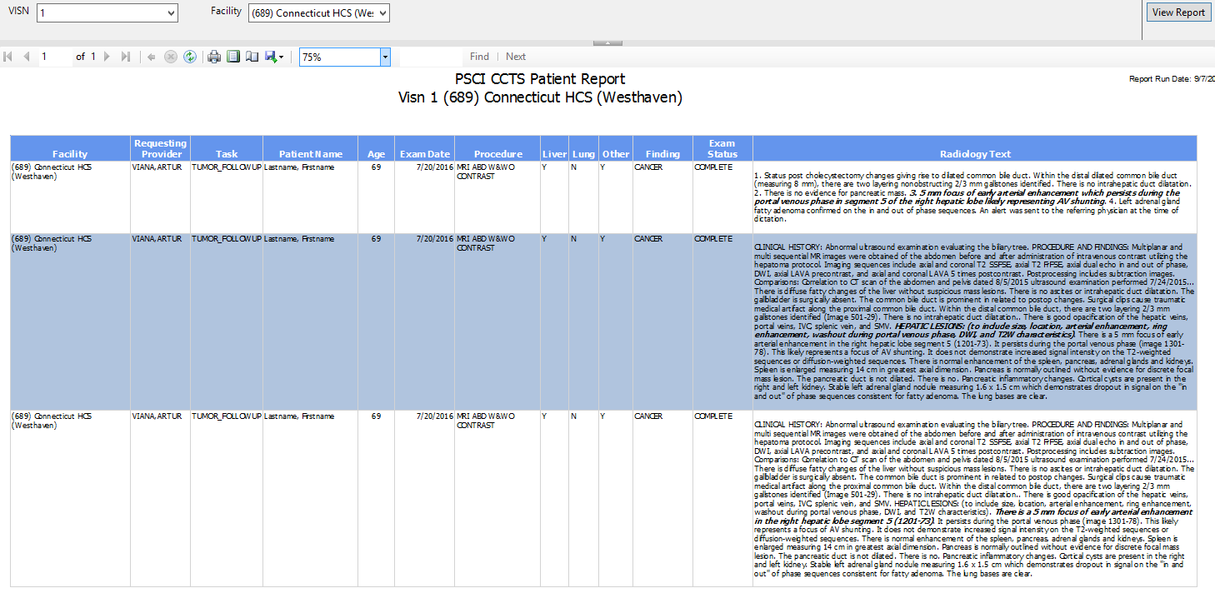
BISL Enterprise NLP Application
Lung
Radiology Project DBs (A01)
SQL Sever
NLP Application
Server
Annotations
Liver
Radiology DBs
Other
Output DBs
CDW
Reporting Tools
SSAS, SSRS, SharePoint
Pyramid Analytics

Slide 34
BISL Enterprise NLP Application
Radiology Project DBs (A01)
SQL Sever
Radiology DBs
Output DBs
CDW
Reporting Tools
SSAS, SSRS, SharePoint
Pyramid Analytics

Slide 35

BISL Enterprise NLP Application
To use HTML to format a text field in an SSRS report, first add HTML markup tags to a field in your dataset, create a textbox in the report, define a report textbox as HTML, and then Import HTML into the Report.
Here is an example of formatting a field in a dataset to HTML:
Case when d.document_type_name='RADIOLOGY_IMPRESSION' then
'<p>' + Left(F74.IMPRESSIONTEXTWP,h.span_begin) + '<i><b>' + SUBSTRING(F74.IMPRESSIONTEXTWP,h.Span_begin,h.Span_end-h.span_begin)
+ '</i></b>' + SUBSTRING(F74.IMPRESSIONTEXTWP,h.span_end,99999) + '</p>'
when d.document_type_name='RADIOLOGY_REPORT' then '<p>' + Left(F74.REPORTTEXTWP,h.span_begin) + '<i><b>' + SUBSTRING(F74.REPORTTEXTWP,h.Span_begin,h.Span_end-h.span_begin)
+ '</i></b>' + SUBSTRING(F74.REPORTTEXTWP,h.span_end,99999) + '</p>' end as RadiologyHTML
Here is part of a sample field displayed on a report (note the Italic & bold text)

Slide 36

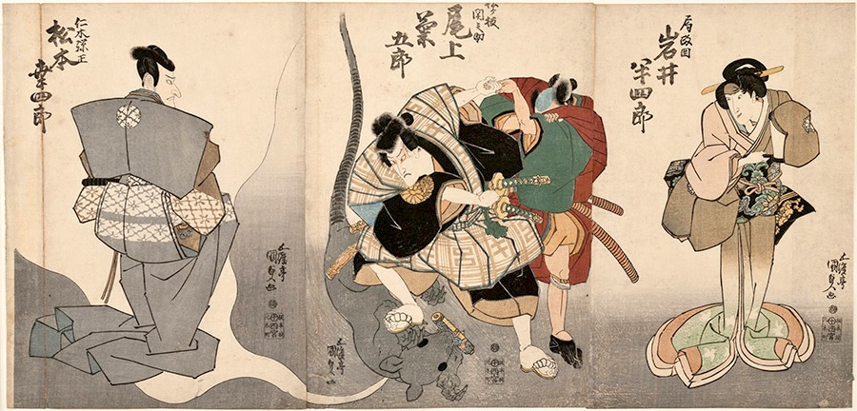
Rats Head Oxen Neck
Rat's head and ox's neck" means that, when we are fighting with the enemy and both he and we have become occupied with small points in an entangled spirit, we must always think of the Way of strategy as being both a rat's head and an ox's neck. Whenever we have become preoccupied with small detail, we must suddenly change into a large spirit, interchanging large with small.
This is one of the essences of strategy. It is necessary that the warrior think in this spirit in everyday life. You must not depart from this spirit in large-scale strategy nor in single combat. Miyamoto Musashi 1584 – 1645

Slide 37
BISL Enterprise NLP Application
Where to go?
Radiology
Pathology
Progress Notes
Projects
Progress Note DB
Lung
Radiology DBs
NLP Application
Servers
Annotations
Liver
Pathology DBs
Other DBs
Others
Output DBs
The architecture is scalable allowing for other text domains to be processed
Virtual Machines (clustered for failover and dynamic allowing for expansion) will allow more than one NLP engine (or versions )to be run for comparisons. Movement to the “cloud” is easier.
Rules are being modularized and optimized to be able to run sequentially for different subject domains or versions.
Governance (where to go) needs to be established
Making use of research innovation.
Reusable products and sharing. Export of annotations.
Domain development
  Progress notes
  Pathology Reports

Slide 38
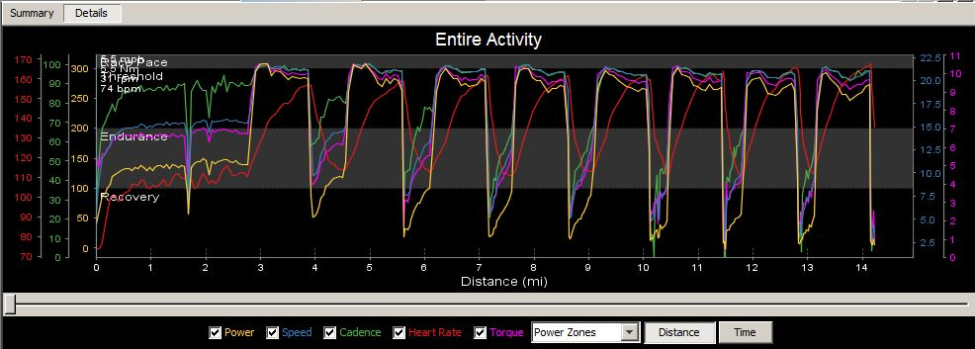
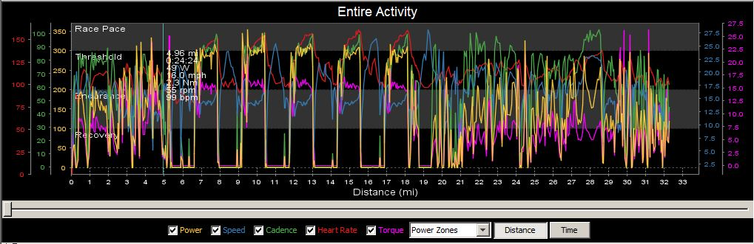
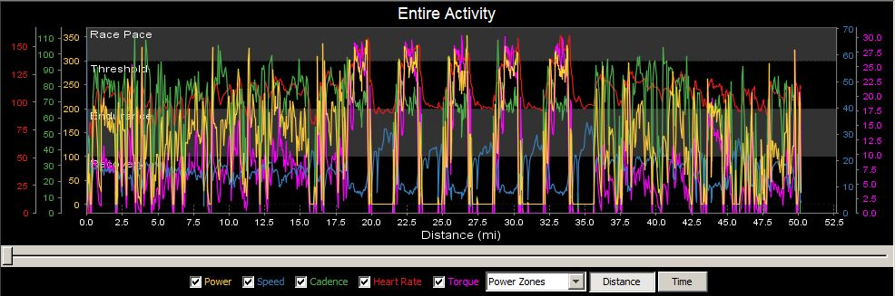
Using data to drive Performance
Training Intervals:
Stationary
Medium Road
Long Road

Slide 39
Mount Washington Race
 | Max | Average
Speed | 11.9 | 4.67
Cadence |  | 79
HR | 177 | 165
Watts | 485 | 239
kJoules | 1436

Slide 40

Finished

